Slide 1
SCS 3251 – Statistics for Data Science
Multiple and Logistic Regression
Notes:
Sometimes there are underlying structures or relationships between predictor variables.
We would like to fit a model that includes all potentially important variables simultaneously.
This would help us evaluate the relationship between a predictor variable and the outcome while controlling for the potential influence of other variables.
This is the strategy used in multiple regression.
Such models are a common first step in providing evidence of a causal connection.

Slide 2
Course Roadmap
Module / Week | Title
1 | Introduction to Statistics for Data Science
2 | Probability
3 | Distribution of Random Variables
4 | Inference
5 | Model Building
6 | Linear Regression
7 | Multiple & Logistic Regression
8 | Guest Speakers & Review
9 | Introduction to Bayesian Inference
10 | Multi-level Models
11 | Markov Chain Monte Carlo
12 | Presentations
13 | Final Exam

Slide 3

Module 7: Learning Objectives
Extend Ordinary Least Squares Linear Regression to several predictors
Apply Logistic Regression to classification problems

Slide 4
Key Topic Overview –
Multiple & Logistic Regression
Why Multiple Regression?
Interdependencies of Predictors
Categorical Predictors
Model Evaluation & Selection
Logistic Regression

Slide 5
MULTIPLE REGRESSION

Slide 6
Why Multiple Regression?
In the previous unit we worked with situations where we could estimate the value of a random variable given that we know the value of an associated variable and the relation between both variables is linear
What to do when many variables may be simultaneously connected to an output?
We want to answer what happens when one variable changes while simultaneously controlling for other variables but also
What happens when many variables are changing at the same time?

Slide 7
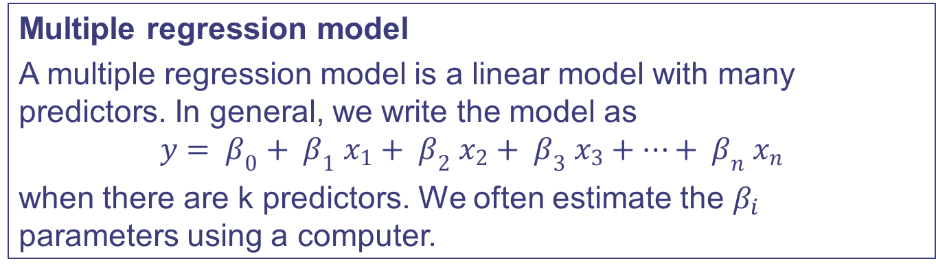
What is Multiple Regression?
Multiple regression model
A multiple regression model is a linear model with many predictors. In general, we write the model as
$$y= β_{0}+ β_{1} x_{1}+ β_{2} x_{2}+ β_{3} x_{3}+…+ β_{n} x_{n}$$
when there are k predictors. We often estimate the $β_{i}$ parameters using a computer.
However, things can be more complicated than this; the predictors can be correlated amongst each other. You will see the term ‘collinearity’ amongst predictors later.

Slide 8
Predictors Not Independent
However things can be more complicated than this, the predictors can be correlated or interact among them.
Key terms to learn are*:
Confounding: general term to indicate that the value of a main effect estimate comes from both the main effect itself and also contamination or bias from higher order interactions.
Alias: When the estimate of an effect also includes the influence of one or more other effects (usually high order interactions) the effects are said to be aliased
*taken from NIST/SEMATECH e-Handbook of Statistical Methods http://www.itl.nist.gov/div898/handbook//pri/section7/pri7.htm#Confounding
Notes:
Sometimes there are underlying structures or relationships between predictor variables.
We would like to fit a model that includes all potentially important variables simultaneously.
This would help us evaluate the relationship between a predictor variable and the outcome while controlling for the potential influence of other variables.
This is the strategy used in multiple regression.
Such models are a common first step in providing evidence of a causal connection.

Slide 9
Model Bias
Two predictor variables are collinear (pronounced as co-linear), when they are correlated, and this collinearity complicates model estimation
Cofounding variables will cause the model to be biased unless it incorporate all variables that are cofounded
More predictors will give you a better fit, but a model can be over-fitted:
The model uses too many predictors for the number of observations
We are including variables that do not add information as they are correlated with the others
Notes:
Two ways to assess correlation among variables
Visual: scatter plot matrix
Analytical: correlation matrix
Verify and / or validate that the relation among variables is linear. This is easily seen in the scatter plots. In the previous examples, the variables CC_Payments and Mtg are linerarly correlated
Make sense of the plot, correlations and p-values before proceeding with a regression. It is very helpful to keep this in mind while looking at the regression results
When two independent variables are correlated you have to be extra cautions when adding both to the model

Slide 10
Categorical Predictors
Last class we had an introduction to categorical values
Let’s review:
There are situations where the independent variables denotes the presence or absence of an attribute: new or old, city, country, etc...
These situations are dealt with by using categorical (or dummy) variables.
The process to convert non-numerical to numerical predictors is called encoding
We will describe how to work with these kind of predictors
Let’s now have a deeper look…
Notes:
We are interested in how to include categorical variables as predictors in a model
A categorical variable describes the presence of an attribute, it can have two or more levels
Example of two levels: gender, spam e-mail (Y/N)
Example of more than two levels: city; Toronto, Ottawa, Montreal, Calgary, Vancouver; occupation; race…
There is no intrinsic order among the categories
Somehow we need to convert a non-numerical into a numerical value
Some methods introduce an order or structure among variables and others do not
It is the discretion of the model developer to introduce this order
In some cases it is obvious that there is an order, i.e. a scale in a survey: not likely at all… likely…. Very likely
In some cases the data has an order but that order has no meaning and should not be carried into the model; i.e. geographical zip codes in the US

Slide 11
Categorical Predictors (Cont’d)
Ordinal
A single column of integers to represent the presence of the different attributes
We introduce an artificial relation that was not there:
Calgary is “twice” Ottawa
Ottawa is greater than and double Toronto
It adds the least possible dimensions to the model
However, it does not apply to a lot of situations. Other approaches are more popular (and usually better).
City | Code
Toronto | 1
Ottawa | 2
Montreal | 3
Calgary | 4
Vancouver | 5

Slide 12
Categorical Predictors (Cont’d)
Dummy coding
Is probably the most commonly used coding scheme. It compares each level of the categorical variable to a fixed reference level.
One category is chosen as the reference (here vector 0, Toronto)
The intercept corresponds to the mean of the reference group
Each slope represents the average difference against the reference when the attribute is present
N - 1 (categories - 1) dummy variables are required
If N variables were used, one would be collinear with the others
City | Ott | Mont | Cal | Van
Toronto | 0 | 0 | 0 | 0
Ottawa | 1 | 0 | 0 | 0
Montreal | 0 | 1 | 0 | 0
Calgary | 0 | 0 | 1 | 0
Vancouver | 0 | 0 | 0 | 1

Slide 13
Categorical Predictors (Cont’d)
One-Hot Encoding
A dummy variable is created for each category
City | Code
Toronto | (1,0,0,0,0)
Ottawa | (0,1,0,0,0)
Montreal | (0,0,1,0,0)
Calgary | (0,0,0,1,0)
Vancouver | (0,0,0,0,1)
No relationship or order is introduced between categories
There is no reference category
It requires as many variables as categories, i.e. the dimension of the vector = number of categories

Slide 14
Categorical Predictors (Cont’d)
Binary coding
We first create an ordinal encoding
We convert those integers into binary numbers
The digits of the binary number are converted into elements of a vector
City | Ordinal | Binary | Encoding
Toronto | 0 | 000 | (0,0,0)
Ottawa | 1 | 001 | (0,0,1)
Montreal | 2 | 010 | (0,1,0)
Calgary | 3 | 011 | (0,1,1)
Vancouver | 4 | 100 | (1,0,0)
It uses less dimensions than dummy or one hot
It introduces some structure or relationships

Slide 15
Categorical Predictors (Cont’d)
Bag of Words
It is used in text analytics to represent the presence and frequency of a certain word
The dimension of the vector will be the numbers of words in the vocabulary we want to study
Each element of the vector defines the frequency of a defined word
It transforms any text in a fixed dimension vector
Applications vary and include analytics on sentiment, popularity, trending, etc…

Slide 16
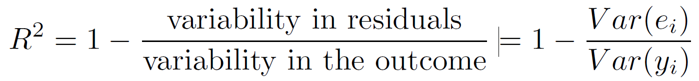

Evaluating the Model - R²
Now we need to put everything together. How do we evaluate how good the model is?
We can determine the amount of variability in the response that was explained by the model using the R² like we did with models with one predictor*
However a model with more predictors will always have a better R²
To account for this statisticians use an enhanced indicator…
*In the previous module we used the following notation

Slide 17
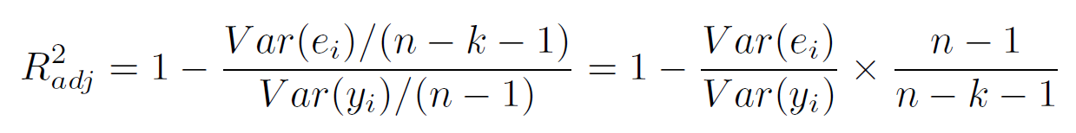
Evaluating the Model - Adjusted R²
Adjusted R² as a tool for model assessment
The adjusted R2 is computed as
where n is the number of cases used to fit the model and k is the number of predictor variables in the model
Notes:
Because k is never negative, the adjusted R² will be smaller (often times just a little smaller) than the unadjusted R².
The reasoning behind the adjusted R² lies in the degrees of freedom associated with each variance.
The unadjusted R² is an overly optimistic estimate of the reduction in variance in the response, and using the degrees of freedom in the adjusted R² formula helps correct this bias
Not always more variables produce a better model. We will see next how to select the optimum variables.

Slide 18
Model Selection Strategies
Sometimes including non-important variables can reduce the accuracy of predictions
Backward elimination begins with the largest (full) model and eliminates variables one-by-one until we are satisfied that all remaining variables are important to the model.
Forward selection starts with no variables included in the model, then it adds in variables according to their importance until no other important variables are found.
These techniques are often referred to as stepwise model selection strategies, because they add or delete one variable at a time as they “step" through the candidate predictors
Notes:
The best model is not always the most complicated.
Stepwise because they add or delete one variable at a time as they “step" through the candidate predictors.
One strategy is the reverse of the other
Stepwise decisions can be made by looking at the R2 or the p-value. The output is not the same and the final selection will depend on the objective in mind.
Criteria to evaluate the importance of variables – R² adjusted
Backward elimination starts with the model that includes all potential predictor variables (full model). Variables are eliminated one-at-a-time from the model until we cannot improve the adjusted R²
Forward selection starts with zero variables. Variables are added variables one-at-a-time until we cannot find any variables that improve the adjusted R²
The strategy within each elimination/addition step is to eliminate/add the variable that leads to the largest improvement in adjusted R²
Criteria to evaluate the importance of variables – p-value
Backward elimination:
Identify the predictor corresponding to the largest p-value.
If the p-value is above the significance level, usually = 0,05, then we drop that variable
Refit the model
Repeat the process.
If the largest p-value is less than = 0,05, then we do not eliminate any predictors and the current model would be our best-fitting model.
Forward selection:
Begin with a model that has no predictors
Fit a model for each possible predictor, identifying the model where the corresponding predictor's p-value is smallest
If that p-value is smaller than = 0,05, we add it to the model
Repeat the process
When none of the remaining predictors can be added to the model and have a p-value less than 0.05, then we stop adding variables and the current model would be our best-fitting model

Slide 19
R² Adjusted and p-value Strategy Comparison
Stepwise selection strategies can use an adjusted R² or the p-value approach
When the sole goal is to improve prediction accuracy, use adjusted R². This is commonly the case in machine learning applications.
When we care about understanding which variables are statistically significant predictors of the response, or if there is interest in producing a simpler model at the potential cost of a little prediction accuracy, then the p-value approach is preferred.
Notes:
Backward elimination:
Identify the predictor corresponding to the largest p-value.
If the p-value is above the significance level, usually = 0,05, then we drop that variable
Refit the model
Repeat the process.
If the largest p-value is less than = 0,05, then we do not eliminate any predictors and the current model would be our best-fitting model.
Forward selection:
Begin with a model that has no predictors
Fit a model for each possible predictor, identifying the model where the corresponding predictor's p-value is smallest
If that p-value is smaller than = 0,05, we add it to the model
Repeat the process
When none of the remaining predictors can be added to the model and have a p-value less than 0.05, then we stop adding variables and the current model would be our best-fitting model

Slide 20
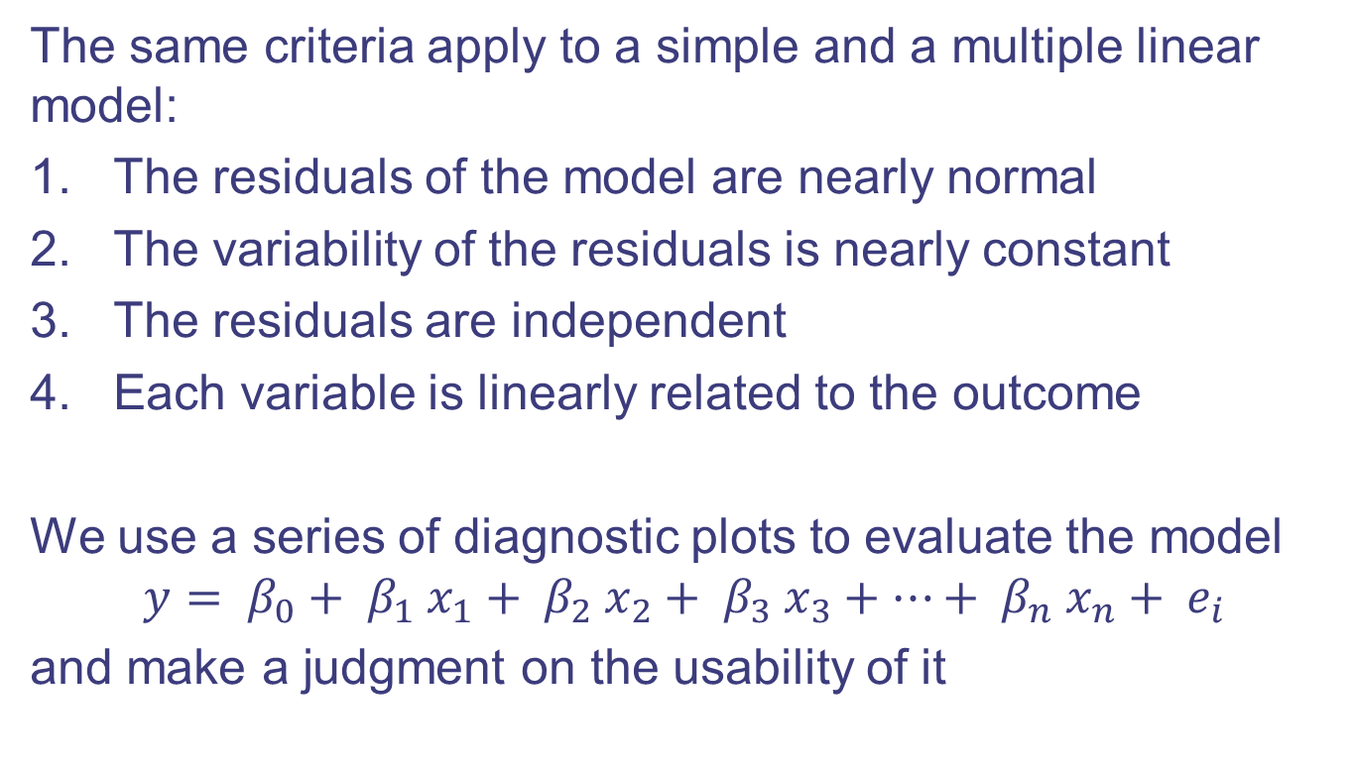
How to Evaluate a Linear Model
The same criteria apply to a simple and a multiple linear model:
The residuals of the model are nearly normal
The variability of the residuals is nearly constant
The residuals are independent
Each variable is linearly related to the outcome
We use a series of diagnostic plots to evaluate the model
$$y= β_{0}+ β_{1} x_{1}+ β_{2} x_{2}+ β_{3} x_{3}+…+ β_{n} x_{n}+ e_{i}$$
and make a judgment on the usability of it
Notes:
The assumption order is different in the textbook for simple and multiple models. We follow the textbook so it is easier to follow for the student.

Slide 21
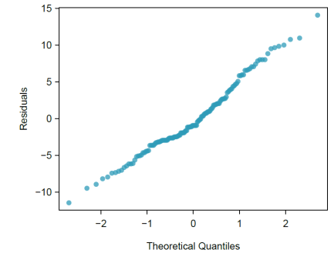
1. Normality Plot
Notes:
The assumption order is different in the textbook for simple and multiple models. We follow the textbook so it is easier to follow for the student.

Slide 22
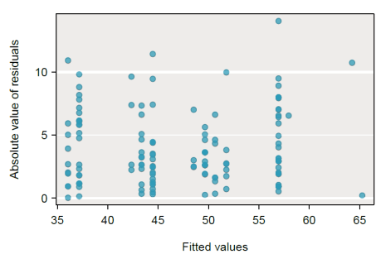
2. Variabilities of Residuals vs. Fitted Values
Notes:
2. We look for identifying deviations from the constant variance assumption

Slide 23
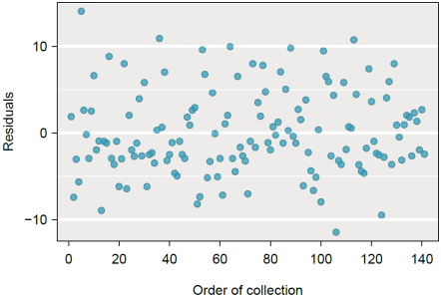
3. Residuals In Order of Collection are Independent
Notes:
3. Plotting residuals in the order that their corresponding observations were collected helps identify connections between successive observations. If it seems that consecutive observations tend to be close to each other, this indicates the independence assumption of the observations would fail.

Slide 24
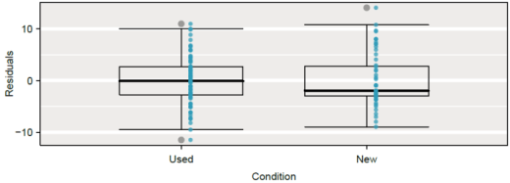
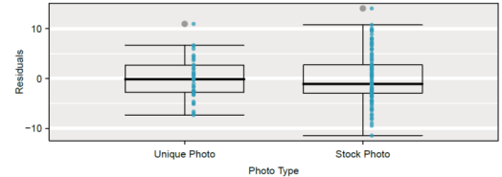
4. Each Variable Linearly Related to the Outcome
Notes:
4.
For continuous, discrete and ordinal variables we check for trends, structure or patterns
For two level variables we check that the variability does not fluctuate across groups

Slide 25
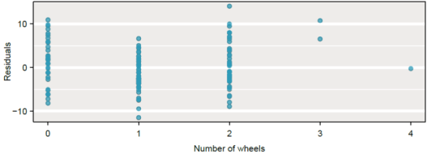
4. Each Variable Linearly Related to the Outcome
Notes:
4.
For continuous, discrete and ordinal variables we check for trends, structure or patterns
For two level variables we check that the variability does not fluctuate across groups

Slide 26
What to Report
If the model is helpful, intercept and slope with its interpretations. Also we need to report how strong the assumptions are…
It is necessary to summarize diagnostics for any model fit. If the diagnostics support the model assumptions, this would improve credibility in the findings.
If the diagnostic assessment shows remaining underlying structure in the residuals, we should try to adjust the model to account for that structure.
If we are unable to do so, we may still report the model but must also note its shortcomings.

Slide 27
Overfitting
In the last module we said: When the analyst is given a set of data, the common practice is to split the data in two:
One set is used to train the model, i.e. determine the coefficients
A second set is used to evaluate how efficient is the model to predict data points not present in the training data
What happens when the model fits the training data very well but it is very poor at predicting data points not used to train the model?
The model is said to be overfitted
In lay terms, it is like trying to get too much information from a sample that is not big enough
Notes:
Overfitted:
In many situations, like when we have small training samples, we may be fitting ‘noise’ or spurious correlations that…
Will not be necessarily present in new data
In an effort to build a good model, we are adding variables or complexity that do not represent a true relationship
In lay terms, it is like to try to get too much information from a sample that is not big enough
Specifically in the case of linear models, you are trying to adjust too many slopes for the data you have
This is related to concepts such us ‘test power’ and ‘sample size’ used in inference statistics and hypothesis tests
A linear model is indeed inference statistics: predict properties of a bigger population based on the information provided by a small population
There are two common scenarios when overfitting happens: small samples or independent correlated variables
In both cases there is not enough information, in one case because not enough data points, on the second because highly correlated variables do not add new information

Slide 28
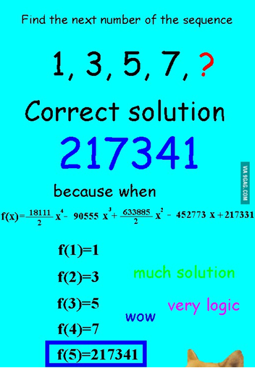
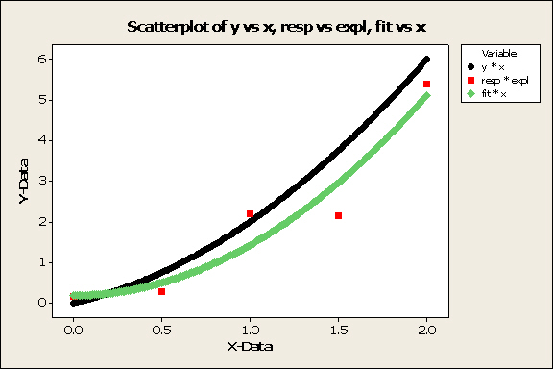
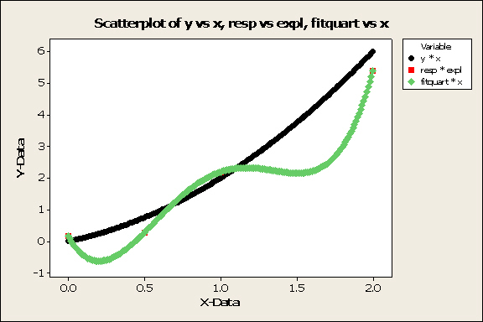
Overfitting (Cont’d)
A typical example happens with polynomials. We saw in the past module that we can apply a linear model to non-linear relations
However this can be abused, causing overfitting
http://stats.stackexchange.com/questions/128616/whats-a-real-world-example-of-overfitting
http://www.ma.utexas.edu/users/mks/statmistakes/ovefitting.html

Slide 29
Practice
We will practice the concepts presented following an example
The data has been simulated for illustrative purposes:
A financial institution has income and expenditure data of its clients and wants to perform a risk analysis to help decide to which customers offer a default mortgage insurance. We will work out this example in this and next module
Data and code in CreditRisk.csv and ‘Module7 MultipleLinearRegressionPractice R.ipynb’

Slide 30
Practice (Cont’d)
City: primary residence of the customer
CC Payments: annualized Credit Card payments or financing the customer did last year. Expenses include categories that are not critical (avoidable)
Wage: annualized wage deposited as direct payments from employees
Cost Living: annual expenses in categories related to groceries, etc… These are considered basic expenses that cannot be avoided
Mtg: Mortgage annual payments
Default: did the customer defaulted his/her mortgage payment last year
Vacations: annual card present expenses done outside of the primary residence. These expenses can be avoided.

Slide 31
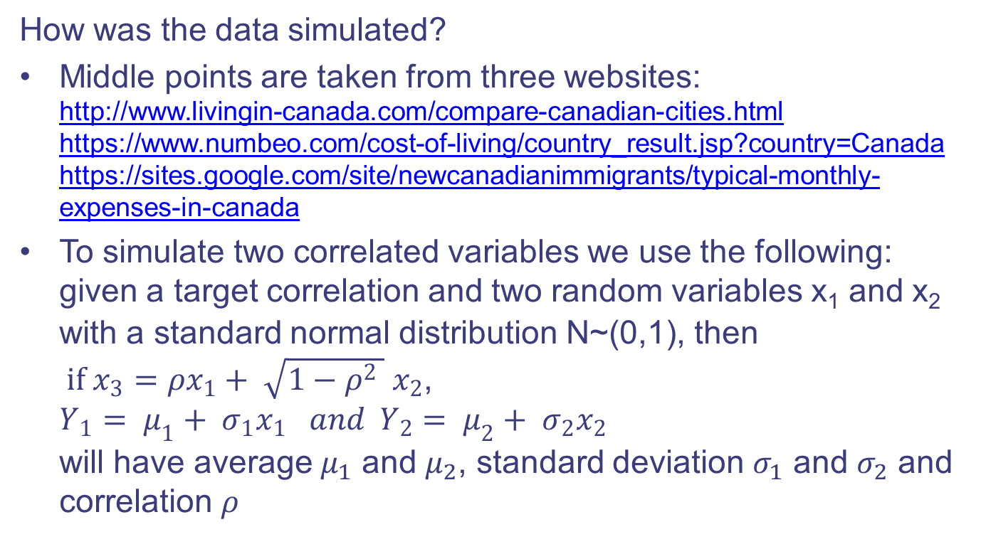
Practice (Cont’d)
How was the data simulated?
Middle points are taken from three websites: http://www.livingin-canada.com/compare-canadian-cities.html https://www.numbeo.com/cost-of-living/country_result.jsp?country=Canada https://sites.google.com/site/newcanadianimmigrants/typical-monthly-expenses-in-canada
To simulate two correlated variables we use the following: given a target correlation and two random variables x₁ and x₂ with a standard normal distribution N~(0,1), then if $x_{3}=ρx_{1}+ \sqrt{1−ρ^{2} } x_{2}$, $Y_{1}= μ_{1}+ σ_{1}x_{1} and Y_{2}= μ_{2}+ σ_{2}x_{2}$ will have average $μ_{1}$ and $μ_{2}$, standard deviation $σ_{1}$ and $σ_{2}$ and correlation $ρ$

Slide 32
Practice (Cont’d)
Vacations is not correlated to any variable
CC Payments (DV) =Wage-Cost_Living-Mtg+error_{1 ,} a negative value means the customer is using the CC to finance him/herself
Wage and Cost_Living are simulated correlated
Mtg is dependent to the city housing value, not correlated to any variable
Default: if CC Payments (DV) is below a certain threshold, i.e. no money left for non critical expenses the customer will default.
Credit Risk data and R code
Notes:
Show:
different techniques to visualize data: matrix scatter plot, histograms in the diagonals and histograms grouped by categorical variable
How front and backward stepwise techniques can yield different values (in the example the differences are minor but in real life they could be substantial)
Misfit: we can get spurious correlations if we choose the wrong variables. If we use city only, it yields as significant as the mtg average was set by city
Mention the hold out and panel technique to evaluate parameter sensitivity to extreme values and model predictive power.

Slide 33
LOGISTIC regression

Slide 34
Why Logistic Regression?
Simple and multiple linear regressions are applied when the response is continuous
These models does not work well when the response is a categorical value with two levels
Is a customer going to buy an item (Y/N)?
Is an e-mail spam (Y/N)?
These situations are better modeled by a type of generalized linear model (GLM): Logistic Regression
GLMs can be thought of as a two-stage modeling approach
First model the response variable using a probability distribution, such as the binomial or Poisson distribution
Second, model the parameter of the distribution using a collection of predictors and a special form of multiple regression

Slide 35
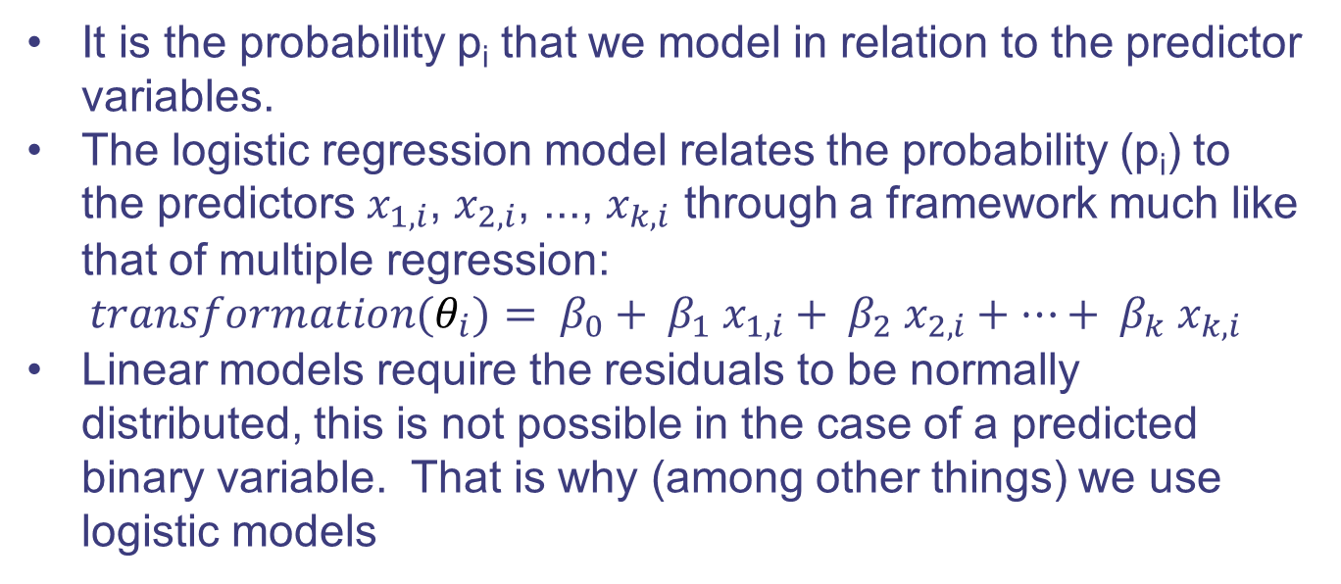
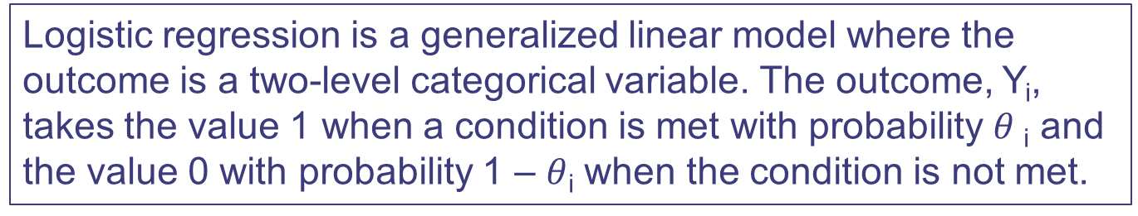
Introduction to Logistic Regression
Logistic regression is a generalized linear model where the outcome is a two-level categorical variable. The outcome, Y_{i}, takes the value 1 when a condition is met with probability $θ$_{i} and the value 0 with probability 1 – $θ$_{i} when the condition is not met.
It is the probability p_{i} that we model in relation to the predictor variables.
The logistic regression model relates the probability (p_{i}) to the predictors $x_{1,i}$, $x_{2,i}$, ..., $x_{k,i}$ through a framework much like that of multiple regression:
$$transformation(θ_{i})= β_{0}+ β_{1} x_{1,i}+ β_{2} x_{2,i}+…+ β_{k} x_{k,i}$$
Linear models require the residuals to be normally distributed, this is not possible in the case of a predicted binary variable. That is why (among other things) we use logistic models

Slide 36
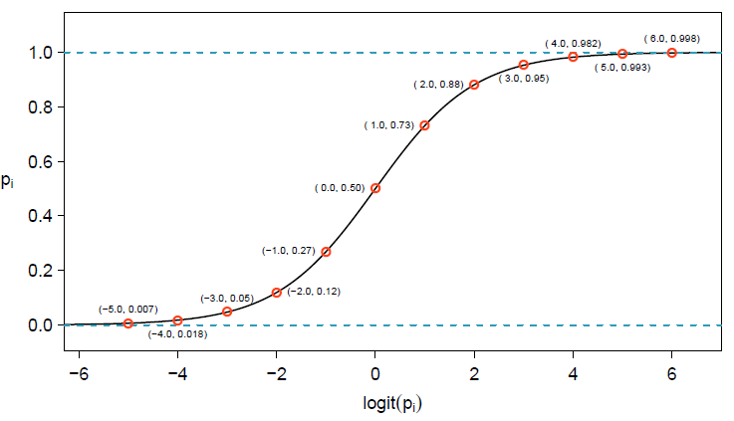
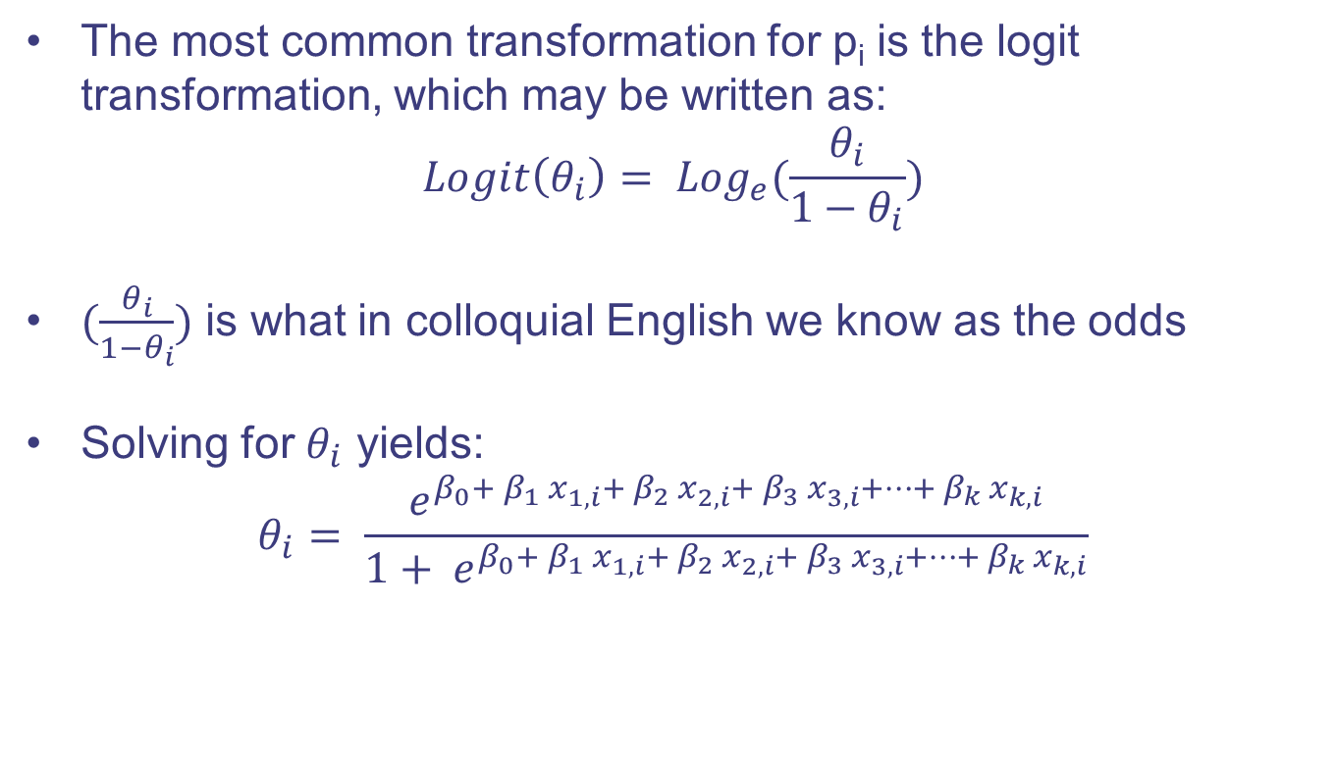
Model Response Variable - Logit Transformation
The most common transformation for p_{i} is the logit transformation, which may be written as:
$$Logit\left(θ_{i}\right)= {Log}_{e}(\frac{θ_{i}}{1−θ_{i}})$$
$(\frac{θ_{i}}{1−θ_{i}})$ is what in colloquial English we know as the odds
Solving for $θ_{i}$ yields:
$$θ_{i}= \frac{e^{β_{0}+ β_{1} x_{1,i}+ β_{2} x_{2,i}+ β_{3} x_{3,i}+…+ β_{k} x_{k,i}}}{1+ e^{β_{0}+ β_{1} x_{1,i}+ β_{2} x_{2,i}+ β_{3} x_{3,i}+…+ β_{k} x_{k,i}}}$$

Slide 37
Model the response
The common practice is to model the response variable taking values of 0 or 1 to represent a no or yes answer
Predictors can be categorical or numerical variables
If outliers are present in predictor variables, the corresponding observations may be especially influential on the resulting model
This is the motivation for omitting the numerical variables by transforming or binning the predictors
TIP: Notation for a logistic regression model
The outcome variable for a GLM is denoted by Y_{i}, where the index i is used to represent observation i.
The predictor variables are represented as follows: x_{1,i} is the value of variable 1 for observation i, x_{2,i} is the value of variable 2 for observation i, and so on.

Slide 38
Some Observations on Logistic Regression
Point estimates will generally change a little - and sometimes a lot - depending on which other variables are included in the model. This is usually due to collinearity in the predictor variables.
A positive coefficient estimate in logistic regression, just like in multiple regression, corresponds to a positive association between the predictor and response variables when accounting for the other variables in the model
A positive coefficient indicates that the probability will increase with the presence of that characteristic

Slide 39
Logistic Model Interpretation
Any classifier will have some error
Every classifier will fall into one of three categories:
The classifier output (based on input characteristics) indicates the absence of the attribute, typically when the output of the model is quite low, say, under 0.05.
The characteristics generally indicate the presence of an attribute, the resulting probability is quite large, say, over 0.95.
The characteristics roughly balance each other out in terms of evidence for and against the classifier and its probability falls in the remaining range
Thresholds are of special importance as they impact the number of items with or without an attribute being correctly classified

Slide 40
Impact of Thresholds (Additional Material)
Play with thresholds to see how the following matrix would be populated in the spam example
What thresholds would you choose?
False Positives: good e-mails going to the spam folder
False Negatives: spam e-mails going to the inbox
 | Actual
Predicted |  | True | False
 | True | True Positives | False Positives
 | False | False Negatives | True Negatives
Notes:
There is no right answer…, the objective is for the student to understand the challenge. Prepare the path for model evaluation in future courses. False positive and false negative rate, ROI curves.

Slide 41
Diagnosis of a Logistic Regression
Logistic regression conditions
There are two key conditions for fitting a logistic regression model:
Each predictor x_{i} is linearly related to logit(p_{i}) if all other predictors are held constant.
Each outcome Y_{i} is independent of the other outcomes.
As we said before, the output is a categorical variable so we cannot impose the normal distribution of the error as a condition or requirement

Slide 42
Modelling a Binomial Event
Let’s first recap the binomial process:
There are m identical trials
Each trial results in one of two outcomes, either a “success,” S or a “failure,” F
θ , the probability of “success” is the same for all trials
Trials are independent
Let Y = number of successes in m trials of a binomial process. Then Y is said to have a binomial distribution with parameters m and q .
Y~Bin(m, q) with the properties: E(Y) = m θ, Var(Y) = m θ(1− θ)

Slide 43

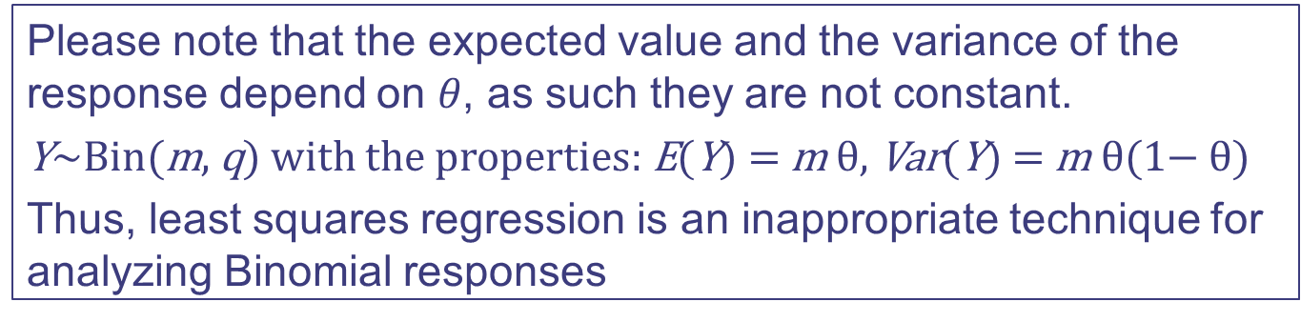
Modelling a Binomial Event (Cont’d)
In the logistic regression we wish to model the proportion of successes on the basis of predictors $x_{1}$, $x_{2}$ , …, $x_{n}$
( Y|$x_{1}$, $x_{2}$ , …, $x_{n}$)~ Bin($m_{i}$ , $θ$ ($x_{1i}\text{, }x_{2i}\text{ , …, }x_{ni}$))
$yi / mi=θ(x_{1i}\text{, }x_{2i}\text{ , …, }x_{ni}$)
With the following conditions
$yi / mi$is an unbiased estimate of $θ(x_{1i}\text{, }x_{2i}\text{ , …, }x_{ni}$)
$yi / mi$varies between 0 and 1
Please note that the expected value and the variance of the response depend on $θ$, as such they are not constant.
Y~Bin(m, q) with the properties: E(Y) = m θ, Var(Y) = m θ(1− θ)
Thus, least squares regression is an inappropriate technique for analyzing Binomial responses
Notes:
Stress that when we model the output as a binomial event we are modelling the proportion of successes conditioned to the value of the predictors / as a function of the predictors.

Slide 44

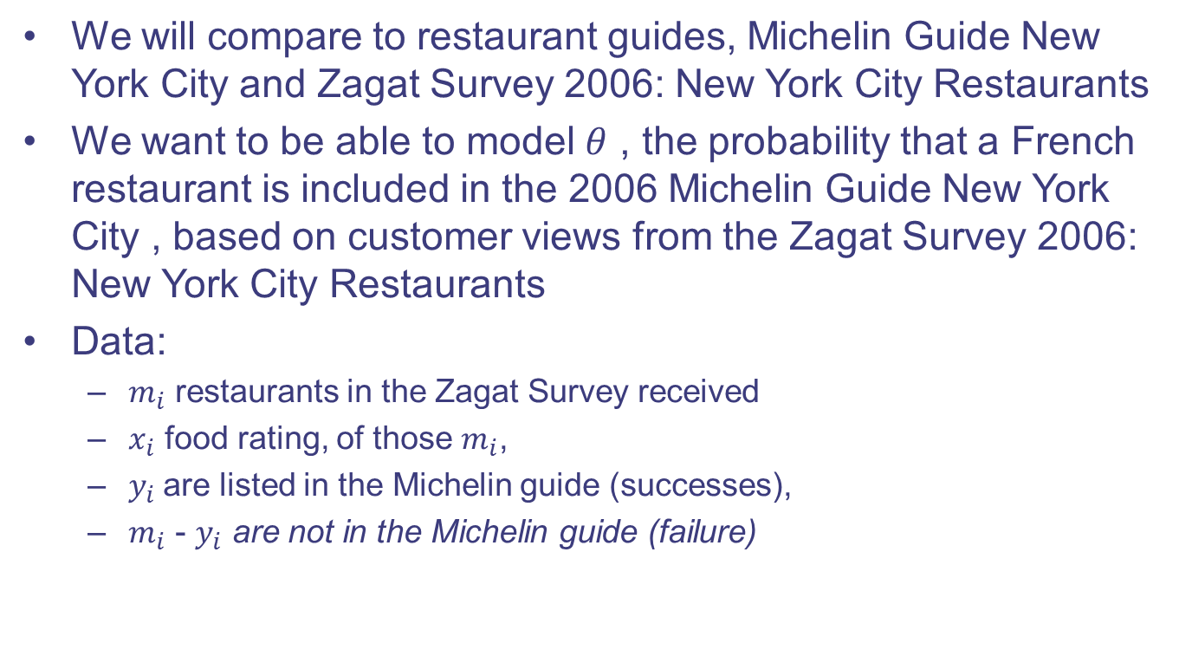
Binomial Event Example
We will compare to restaurant guides, Michelin Guide New York City and Zagat Survey 2006: New York City Restaurants
We want to be able to model $θ$ , the probability that a French restaurant is included in the 2006 Michelin Guide New York City , based on customer views from the Zagat Survey 2006: New York City Restaurants
Data:
$m_{i}$ restaurants in the Zagat Survey received
$x_{i}$ food rating, of those $m_{i}$,
$y_{i}$are listed in the Michelin guide (successes),
$m_{i}$ - $y_{i}$ are not in the Michelin guide (failure)

Slide 45

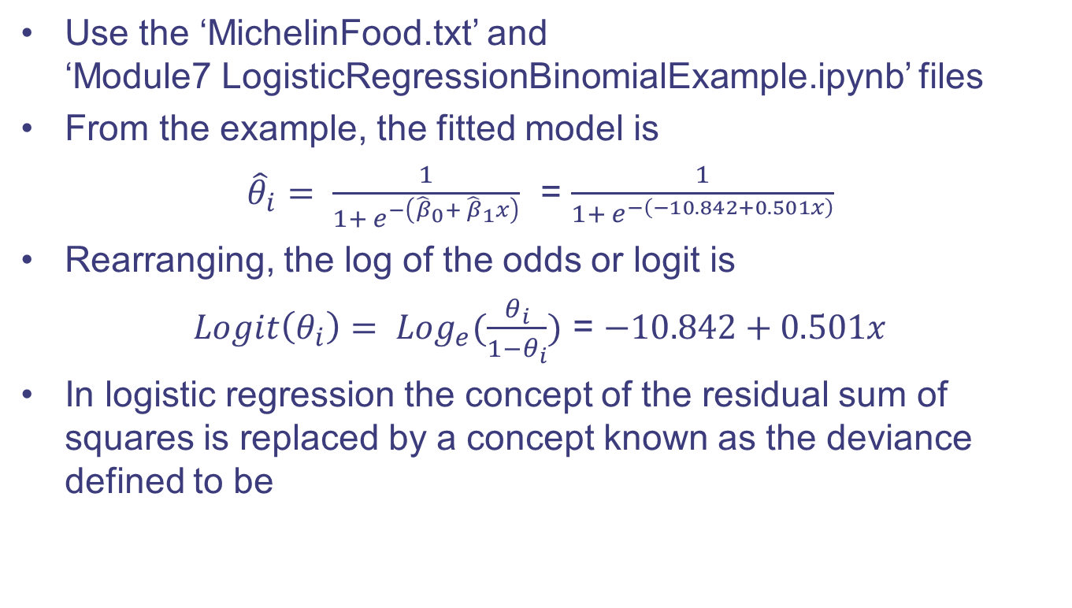
Binomial Event Example (Cont’d)
Use the ‘MichelinFood.txt’ and ‘Module7 LogisticRegressionBinomialExample.ipynb’ files
From the example, the fitted model is
${\hat{θ}}_{i}= \frac{1}{1+ e^{−\left({\hat{β}}_{0}+ {\hat{β}}_{1}x\right)}}$ = $\frac{1}{1+ e^{−\left(−10.842+0.501x\right)}}$
Rearranging, the log of the odds or logit is
$Logit\left(θ_{i}\right)= {Log}_{e}(\frac{θ_{i}}{1−θ_{i}})$ = $−10.842+0.501x$
In logistic regression the concept of the residual sum of squares is replaced by a concept known as the deviance defined to be
where
Notes:
Show on the backboard what a good and bad model sigmoid looks like

Slide 46
Binomial Event Example (Cont’d)
From the software/example:
Null deviance: 61.427 on 13 degrees of freedom
Residual deviance: 11.368 on 12 degrees of freedom
Chi Square test of deviance vs. residuals = 0.498
P(G2 > 11.368) = 0.498
we fail to reject the Null hypothesis, that the model is appropriate
Note: different models are compared by comparing the deviances using a chi square distribution

Slide 47






Binomial Event Example (Cont’d)
Recall that for linear regression
Since the deviance can be written as
where S are the successes in the data and M are from the model
In this specific example
The difference in these two deviances and its p-value is given by
Notes:
The objective here is not for the students to understand all the math behind the calculation but to provide the empirical methods and rules to be able to play with the data

Slide 48

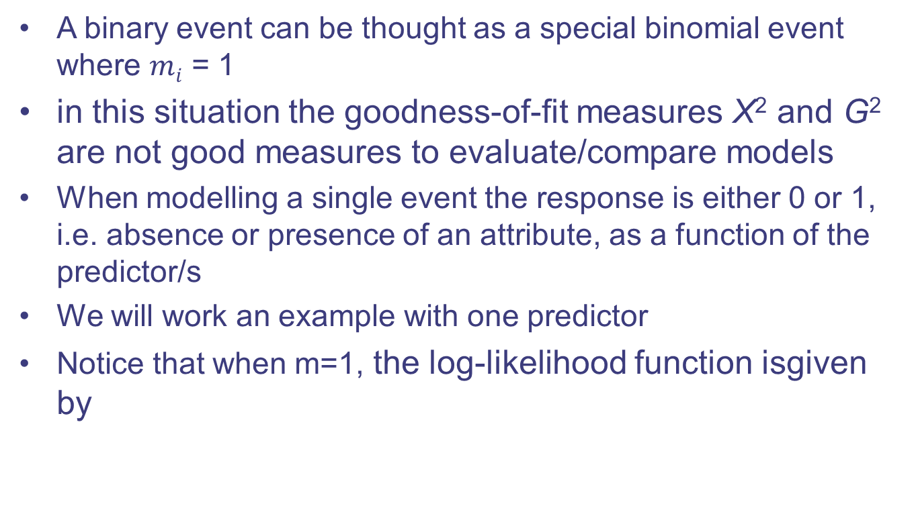
Modelling a Binary Event
A binary event can be thought as a special binomial event where $mi$ = 1
in this situation the goodness-of-fit measures X² and G² are not good measures to evaluate/compare models
When modelling a single event the response is either 0 or 1, i.e. absence or presence of an attribute, as a function of the predictor/s
We will work an example with one predictor
Notice that when m=1, the log-likelihood function isgiven by

Slide 49
Binary Event Example
Use the MichelinNY.csv and the Module7 LogisticRegressionBinaryExample.ipynb files
Both logisticmetric examples were taken from:
S.J. Sheather, A Modern Approach to Regression with R,
DOI: 10.1007/978-0-387-09608-7_1, © Springer Science + Business Media LLC 2009
This book offers a very good coverage of different types of regression, including topics not covered here such as transformation of variables. At some points it may be to ‘mathy’ for this course
Notes:
The objective is to provide the basic code and introduction of the code to run a binary model.

Slide 50
Before we go…
“All models are wrong, but some are useful”-George E.P. Box
The truth is that no model is perfect. However, even imperfect models can be useful. Reporting a awed model can be reasonable so long as we are clear and report the model's shortcomings.
Caution: Don't report results when assumptions are grossly violated
While there is a little leeway in model assumptions, don't go too far. If model assumptions are very clearly violated, consider a new model, even if it means learning more statistical methods or hiring someone who can help.

Slide 51
Homework
Using the data file nyc.csv where (source The source of the data is the following restaurant guide book Zagat Survey 2001: New York City Restaurants , Zagat, New York ):
Y = Price = the price (in $US) of dinner (including 1 drink & a tip)
x 1 = Food = customer rating of the food (out of 30)
x 2 = Décor = customer rating of the decor (out of 30)
x 3 = Service = customer rating of the service (out of 30)
x 4 = East = dummy variable = 1 (0) if the restaurant is east (west) of Fifth Avenue

Slide 52
Homework
Develop a regression model that directly predicts the price of dinner (in dollars) using a subset or all of the 4 potential predictor variables listed above.
(b) Determine which of the predictor variables Food, Décor and Service has the largest estimated effect on Price? Is this effect also the most statistically significant?
(c) If the aim is to choose the location of the restaurant so that the price achieved for dinner is maximized, should the new restaurant be on the east or west of Fifth Avenue?
(d) Does it seem possible to achieve a price premium for “setting a new standard for high-quality service in Manhattan” for Italian restaurants?

Slide 53
Further Reading
Both logisticmetric examples and some data files were taken from:
S.J. Sheather, A Modern Approach to Regression with R,
DOI: 10.1007/978-0-387-09608-7_1, © Springer Science + Business Media LLC 2009
This book offers a very good coverage of different types of regression, including topics not covered here such as transformation of variables. At some points it may be to ‘mathy’ for this course however it is a very good regression textbook with examples and R code provided.

Slide 54
Next Class
Review
Guest Speakers

